Slide 1
Employee Data Analysis using Excel
STUDENT NAME: Vijayalakshmi K
REGISTER NO:312211281,
E858CDD1003D1A48CB547E48DF025DAE
DEPARTMENT: COMMERCE(B.COM(GENERAL))
COLLEGE: MGR Janaki college of arts and science for women

Slide 2
PROJECT TITLE
Using Pivot Tables for Employee Turnover Analysis

Slide 3


AGENDA
Problem Statement
Project Overview
End Users
Our Solution and Proposition
Dataset Description
Modelling Approach
Results and Discussion
Conclusion
3/21/2024 Annual Review

Slide 4

PROBLEM STATEMENT
Employee turnover is a critical issue for organizations, as high turnover rates can lead to increased costs, decreased morale, and loss of organizational knowledge.
To better understand and manage employee turnover, it is essential to analyse various factors such as department, tenure, age, job role, and reasons for leaving.
Using pivot tables will allow for the dynamic organization and summarization of large datasets, enabling the organization to gain actionable insights into the factors contributing to employee turnover.

Slide 5

PROJECT OVERVIEW
The goal of this project is to analyze employee turnover data using pivot tables.
To identify trends, patterns, and potential causes of turnover within an organization.
By leveraging pivot tables, this project aims to provide a clearer understanding of turnover rates across different departments, positions, and demographic factors.

Slide 6

WHO ARE THE END USERS?
Human Resources (HR) Team
HR Managers/Directors
Department Heads/Team Leaders
Senior Leadership/Executives:
Business Analysts/Data Analysts
Compensation & Benefits Teams
Recruitment Teams

Slide 7

OUR SOLUTION AND ITS VALUE PROPOSITION
Conditional formatting- missing
Filter- remove
Formula- performance
Pivot-summary
Graph- data visualiztion

Slide 8
Dataset Description
ID NO
First Name
Last Name
Start Date
Employee Status
Employee Type
Pay Zone
Employee Classification Type
Current Employee Rating

Slide 9

THE "WOW" IN OUR SOLUTION
•Performance level=IFS(Z8>=5,”VERY HIGH”,Z8>=4,”HIGH”,Z8>=3,”MED”, TRUE, “LOW”)
3/21/2024 Annual Review
‹#›

Slide 10
MODELLING
1. Data Collection:
Gather relevant employee data
Job titles
Department.
2. Key Metrics to Analyze:
Turnover Rate
Turnover by Department
Turnover by Position.
3. Data Preparation:
Ensure data cleanliness
Missing values
Standardizing.
4.Pivot Table Setup
Create pivot tables that summarize the data for each of the key metrics
Use filters to drill down into specific departments
Roles, or time periods.
‹#›

Slide 11
5. Analysis & Insights:
Analyse trends
Identify key periods of turnover
Correlate turnover with other factors.
6. Visualizations:
Use charts and graphs based on pivot table data
Create dashboards to allow easy access and understanding of the turnover patterns.
7. Recommendations:
1. Based on the analysis
2. Suggest strategies for employee retention.

Slide 12
RESULTS
PIVOT TABLE
Row Labels | Sum of ID NO | Sum of Current Employee Rating
Bartholomew | 3439 | 3
Khimich | 3439 | 3
2022 | 3439 | 3
Bobby | 3444 | 3
Rodgers | 3444 | 3
2021 | 3444 | 3
Deepa | 3438 | 3
Nguyen | 3438 | 3
2018 | 3438 | 3
Edward | 3429 | 4
Buck | 3429 | 4
2018 | 3429 | 4
Jac | 3435 | 3
McKinzie | 3435 | 3
2018 | 3435 | 3
Jasmine | 3431 | 3
Onque | 3431 | 3
2019 | 3431 | 3
Joseph | 3436 | 5
Martins | 3436 | 5
2022 | 3436 | 5
Kaylah | 3442 | 2
Moon | 3442 | 2
2019 | 3442 | 2
Kristen | 3443 | 3
Tate | 3443 | 3
2021 | 3443 | 3
Latia | 3433 | 4
Costa | 3433 | 4
2022 | 3433 | 4
Maruk | 3432 | 3
Fraval | 3432 | 3
2020 | 3432 | 3
Michael | 3430 | 2
Riordan | 3430 | 2
2021 | 3430 | 2
Myriam | 3437 | 5
Givens | 3437 | 5
2023 | 3437 | 5
Paula | 3428 | 3
Small | 3428 | 3
2023 | 3428 | 3
Prater | 3441 | 4
Jeremy | 3441 | 4
2019 | 3441 | 4
Reid | 3445 | 4
Park | 3445 | 4
2021 | 3445 | 4
Sharlene | 3434 | 2
Terry | 3434 | 2
2020 | 3434 | 2
Uriah | 3427 | 4
Bridges | 3427 | 4
2019 | 3427 | 4
Xana | 3440 | 3
Potts | 3440 | 3
2019 | 3440 | 3
Grand Total | 65284 | 63
‹#›

Slide 13
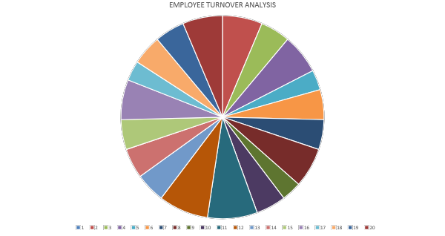
RESULTS

Slide 14
conclusion
Using Pivot Tables for Employee Turnover Analysis:
Pivot tables provide a powerful and flexible tool for analyzing employee turnover.
By transforming raw data into meaningful insights, they allow organizations to easily identify trends, problem areas, and potential causes of employee exits.
Through customized views, HR teams can monitor turnover rates by department, role, tenure, and demographics, enabling more targeted retention strategies.
The analysis not only helps reduce the costs and disruptions associated with turnover but also supports proactive workforce planning
One of the most critical challenges in human resource management: employee retention.

